Slide 1

Solar power regression project
PROJECT TEAM 3
Prapanj KM
Sowmini S
Bandaru Bharath Kumar
Saranya Prasad L
Deepa B
Gaurav Moreshwar Gondane
Mihir Atul Humnabadkar

Slide 2
INDEX
Project objective and dataset
Variable description
Exploratory data analysis
Histograms
Boxplots
Scatter plots
Bar charts
Density plots
Skewness
Kurtosis
Heatmap
Outlier detection
Scaling

Slide 3
Project objective and dataset
The variable to be predicted is continuous energy production.
The primary goal is to model energy production as a function of environmental variables using regression.
The dataset solarpowergeneration.csv has been provided for the project.
It contains 10 variables and 2920 rows.

Slide 4
Variable description
Sr. No | Variable | Units
1 | distance_to_solar_moon | radians
2 | temperature | Degrees Celcius
3 | Wind_direction | Degrees (0-360)
4 | Wind_speed | Meters per second
5 | Sky_cover | Scale from 0 to 4
6 | Visibility | kilometers
7 | Humidity | percentage
8 | Average_wind_speed | Meters per second
9 | Average_pressure | Mercury inches
10 | Power_generated | Jules

Slide 5
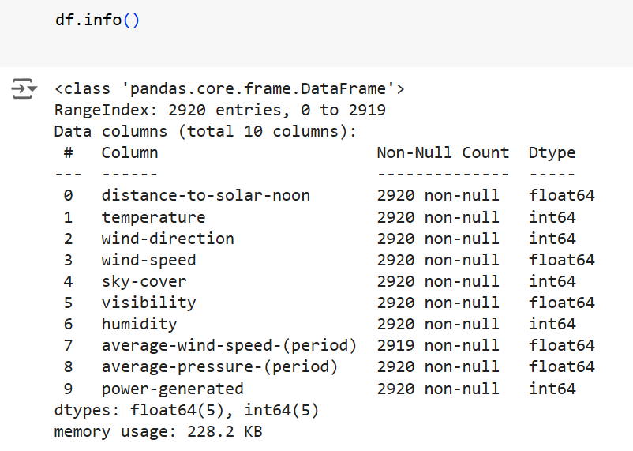
Exploratory data analysis
EDA has been done using pandas, numpy, seaborn and matplotlib.

Slide 6
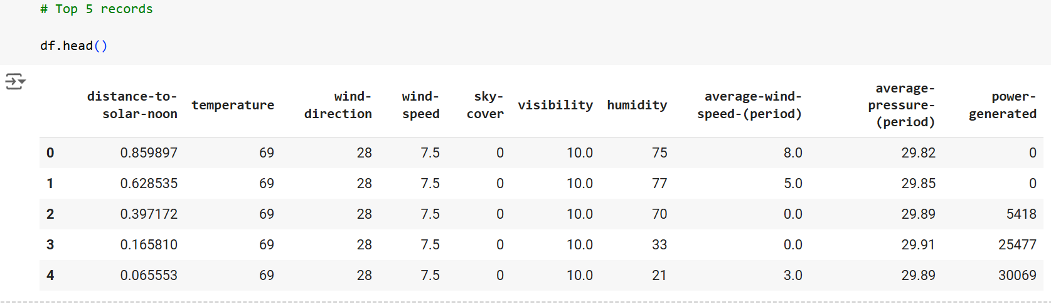
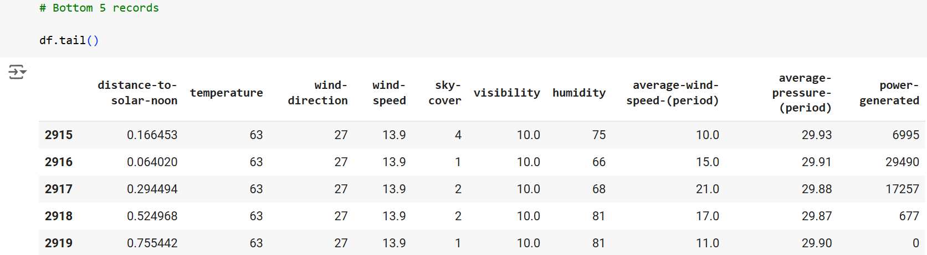
Exploratory data analysis

Slide 7
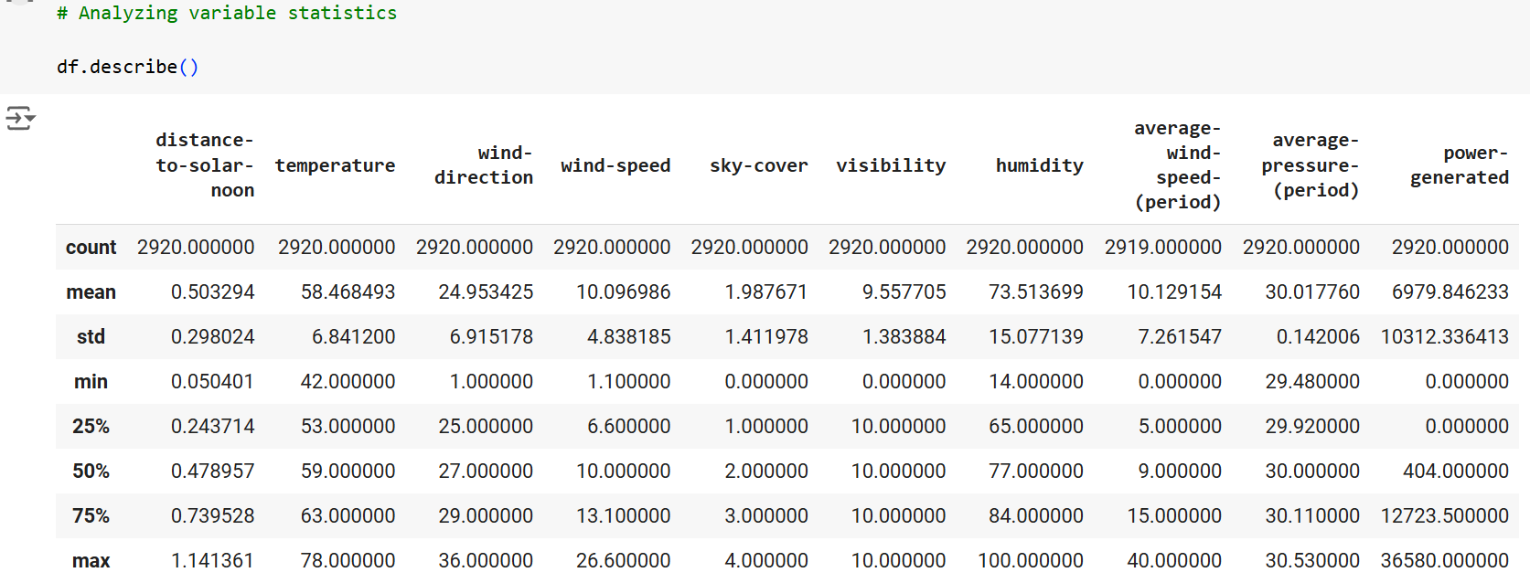
Exploratory data analysis

Slide 8
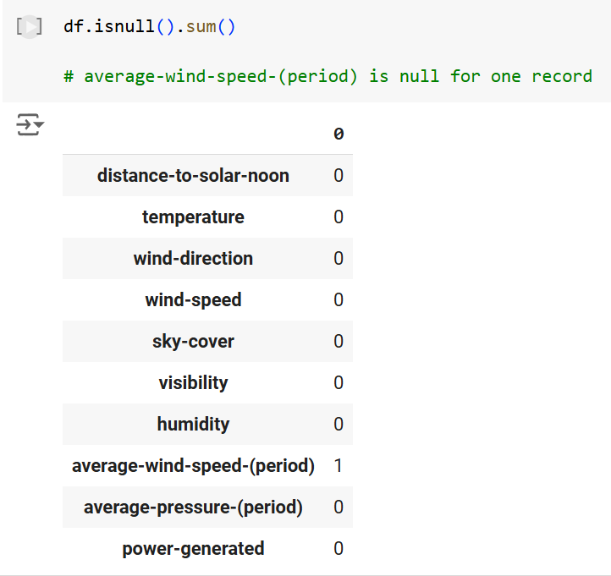
Exploratory data analysis

Slide 9
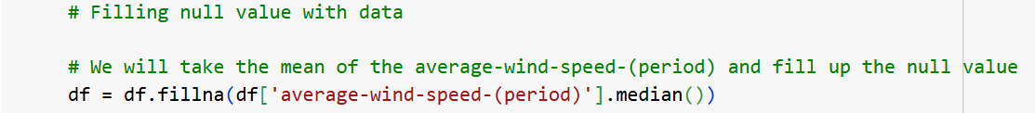
Exploratory data analysis
The empty value has been filled with median of that column
There are no categorical variables in the dataset so one hot encoding or label encoding has not been done.

Slide 10
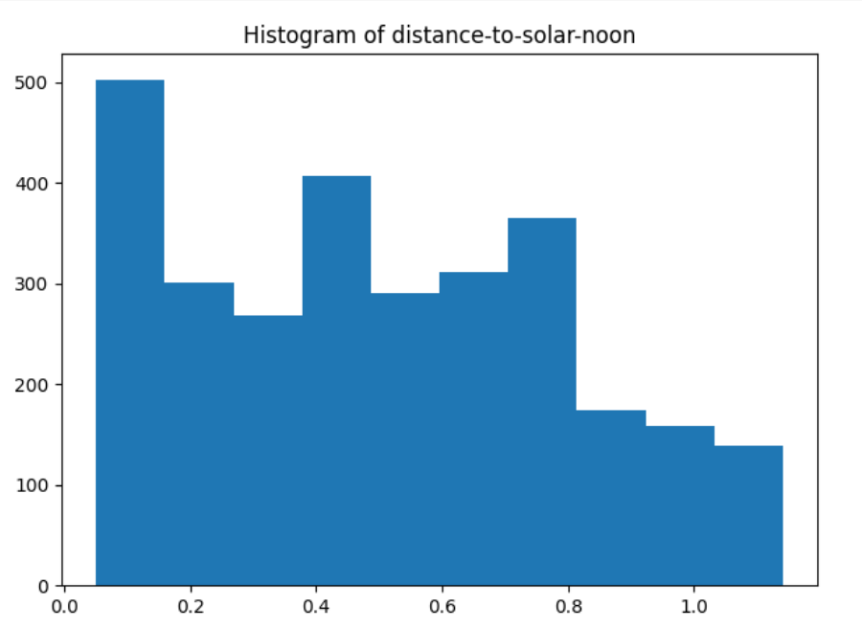
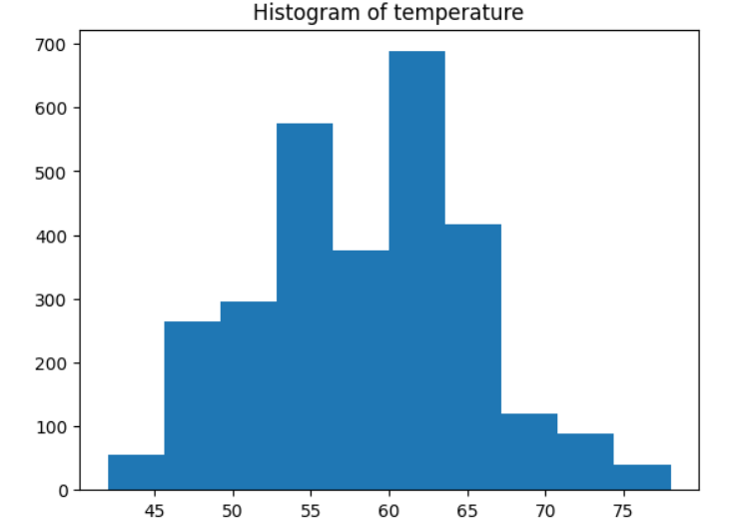
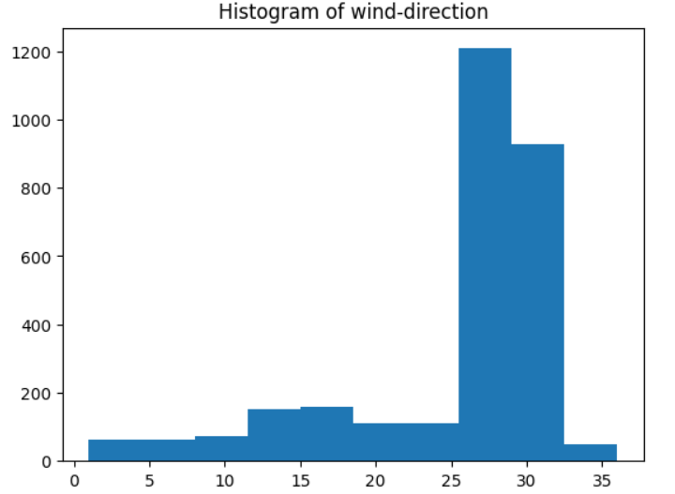
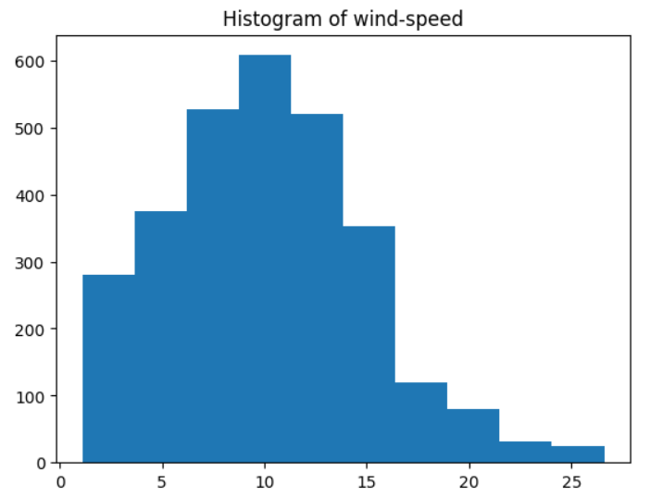
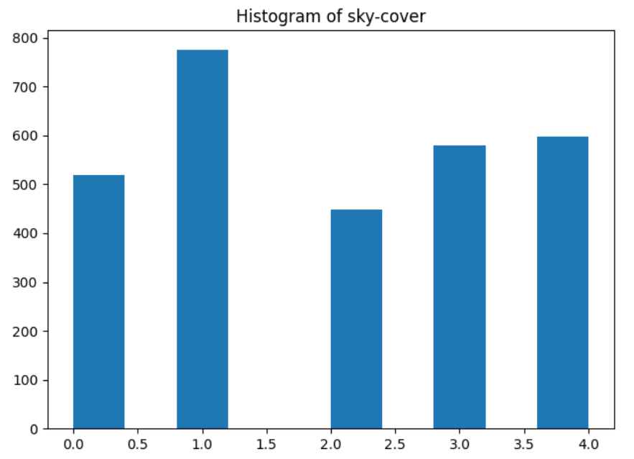
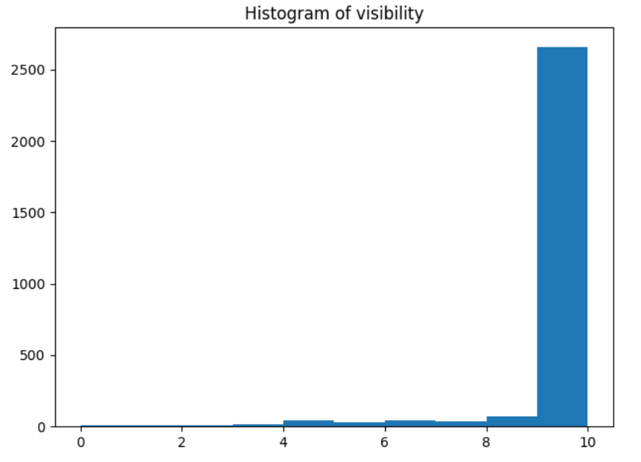
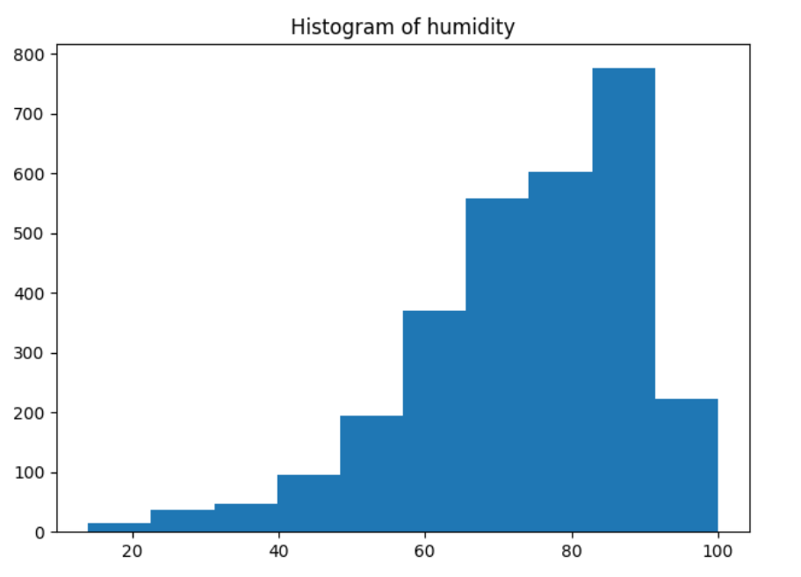
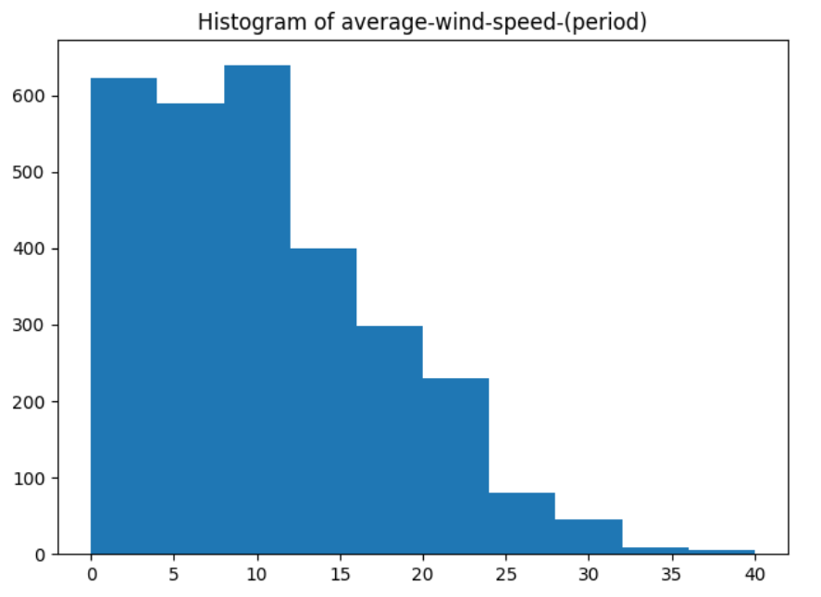
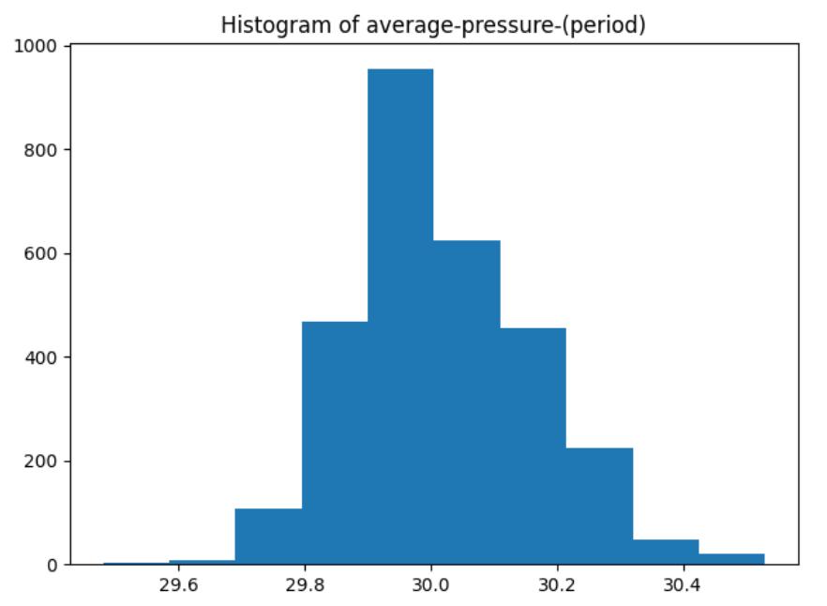
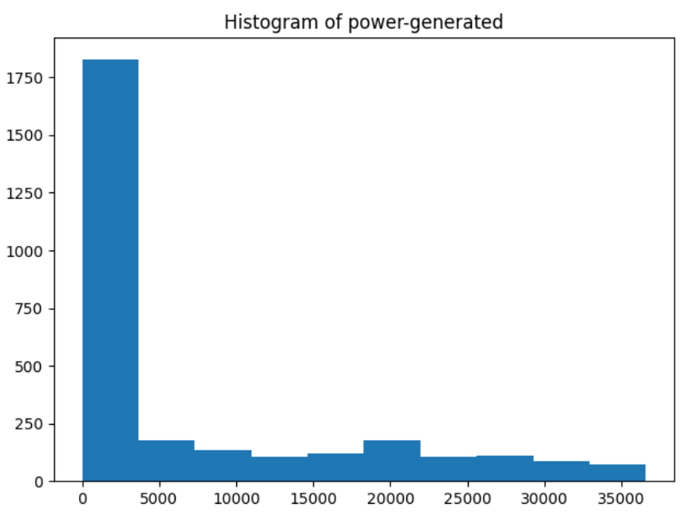
histograms

Slide 11
Histogram insights
Distance-to –solar-noon, temperature, sky-cover and average pressure period have a normal distribution of data.
Wind-direction, visibility and humidity are left-skewed.
Wind-speed period and power generated are right-skewed.
Wind-speed is having a kind of normal distribution but slightly right-skewed.

Slide 12
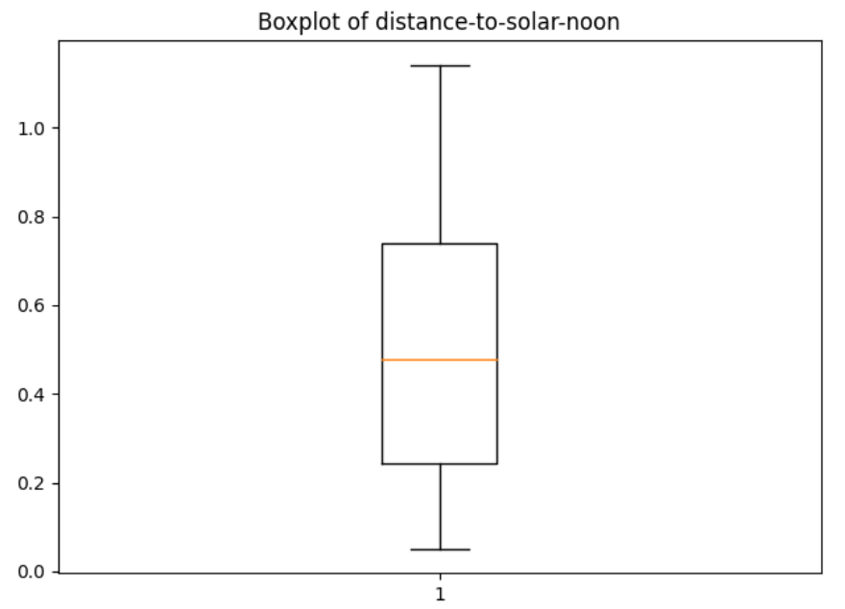
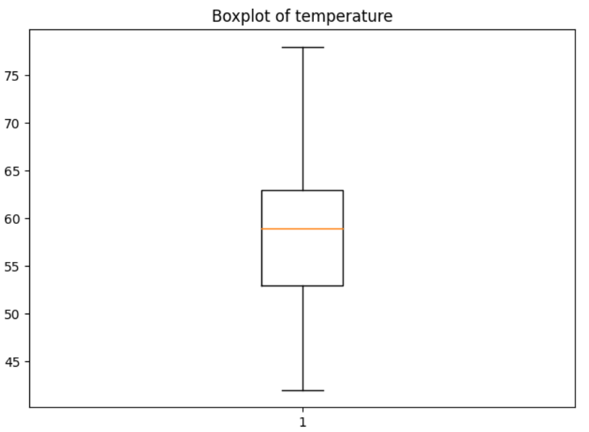
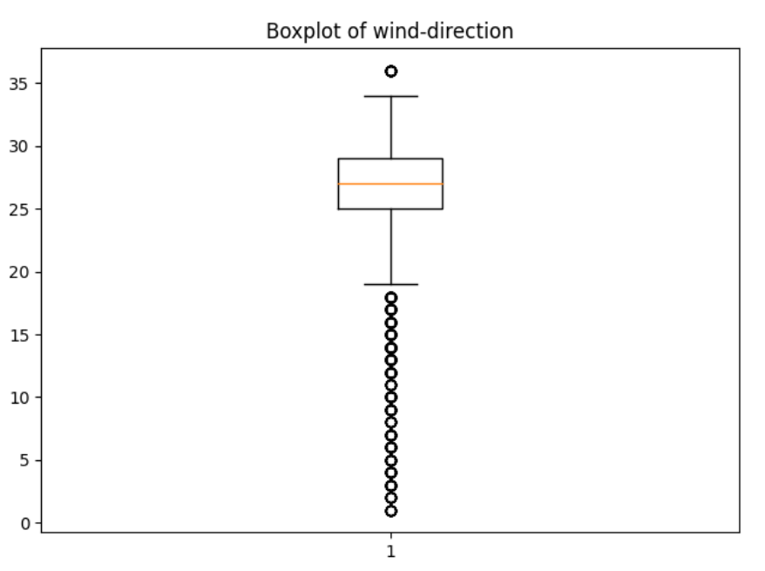
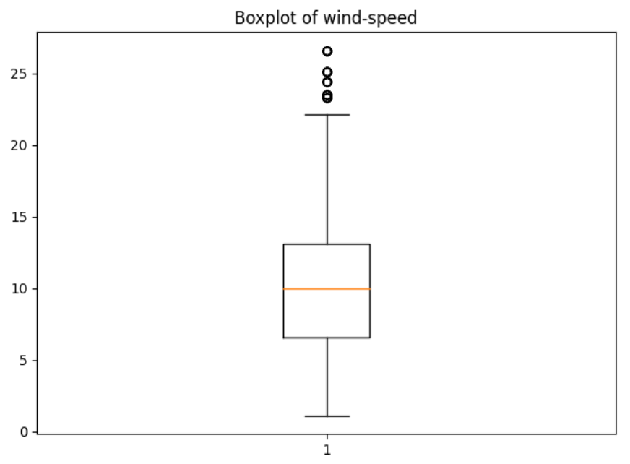
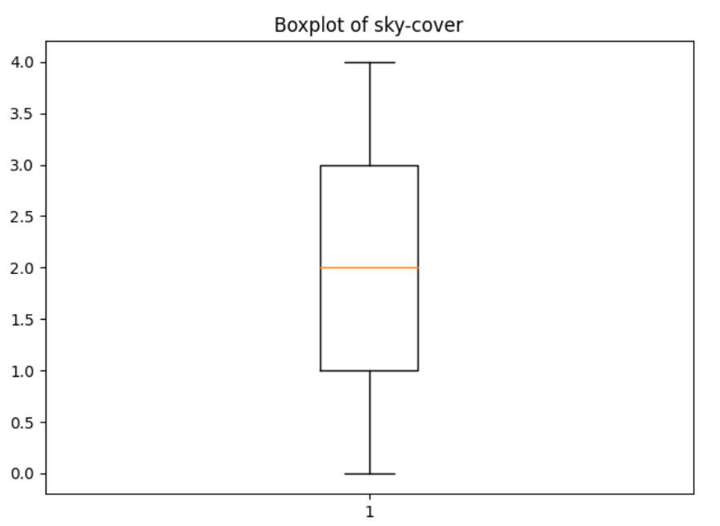
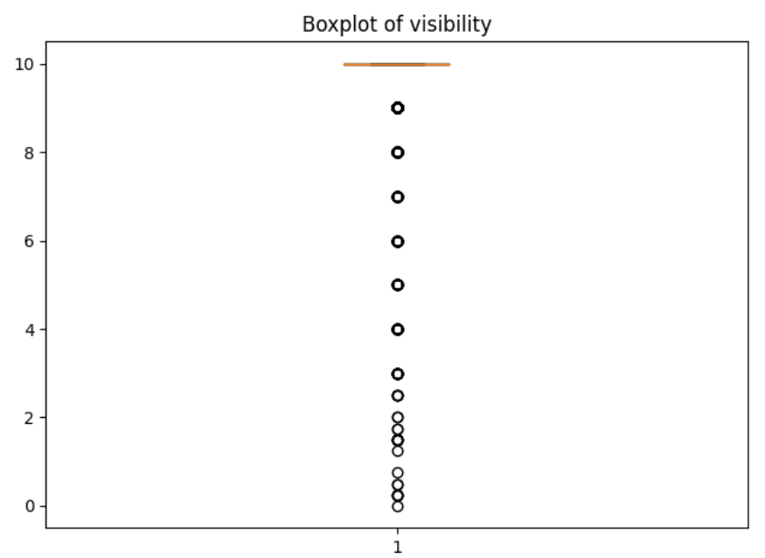
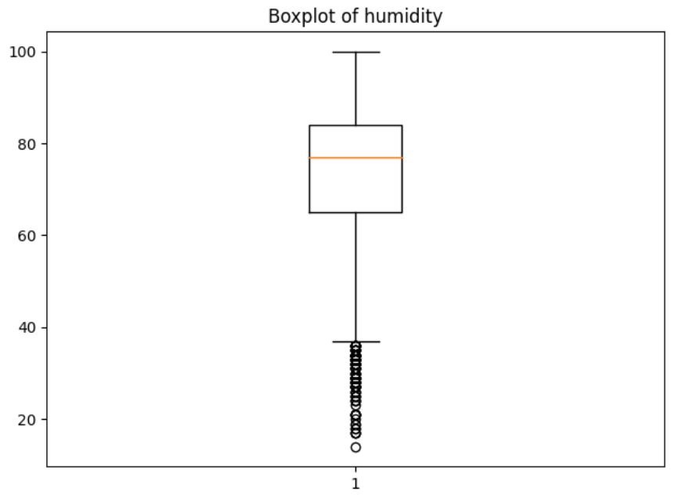
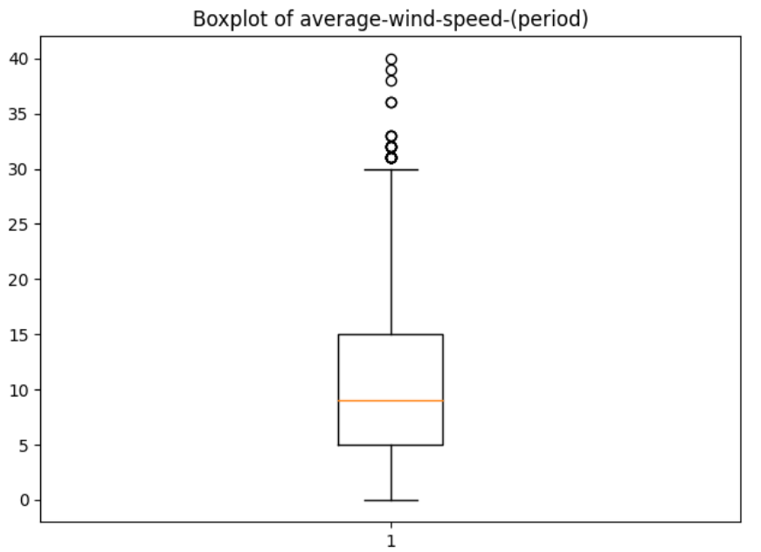
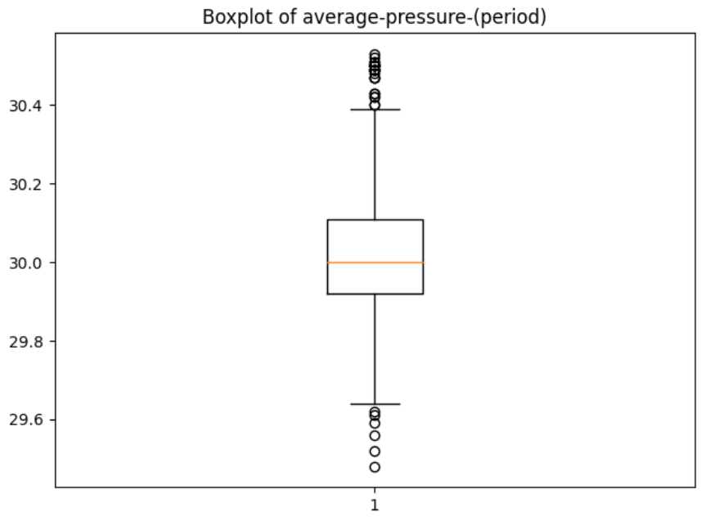
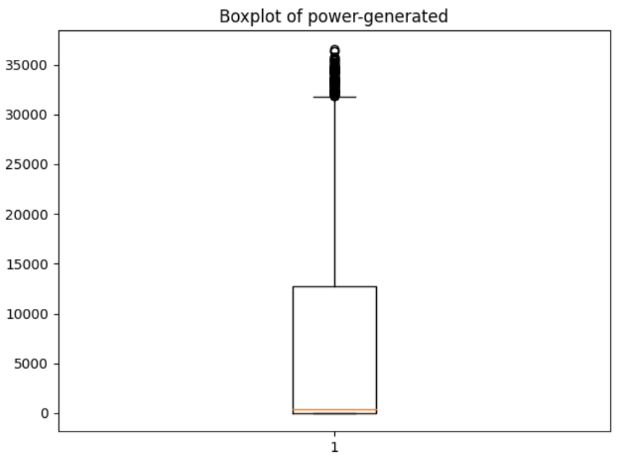
BOX PLOTS

Slide 13
BOX PLOTS insights
Distance-to-solar-noon, temperature and sky-cover have no outliers.
Wind-speed, average wind-speed-period, humidity and average-pressure-period have outliers but in reasonable level.
Wind direction and visibility have a lot of outliers.

Slide 14
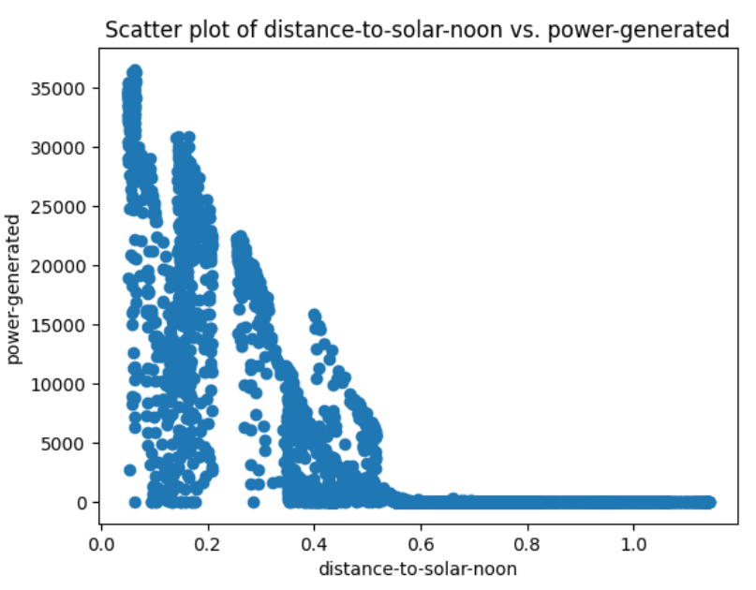
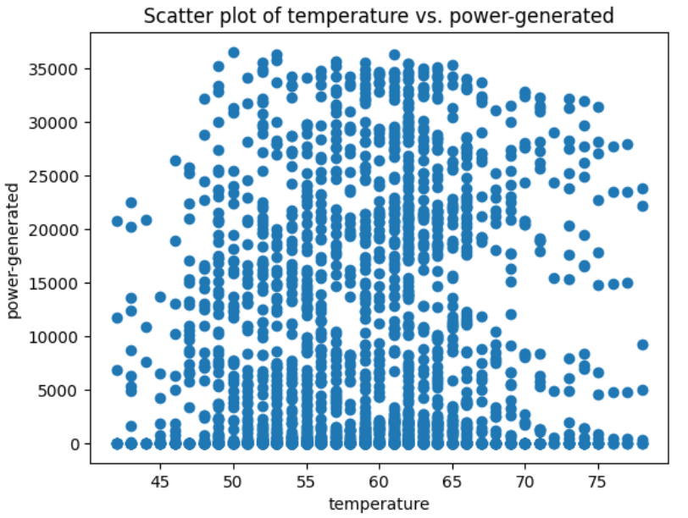
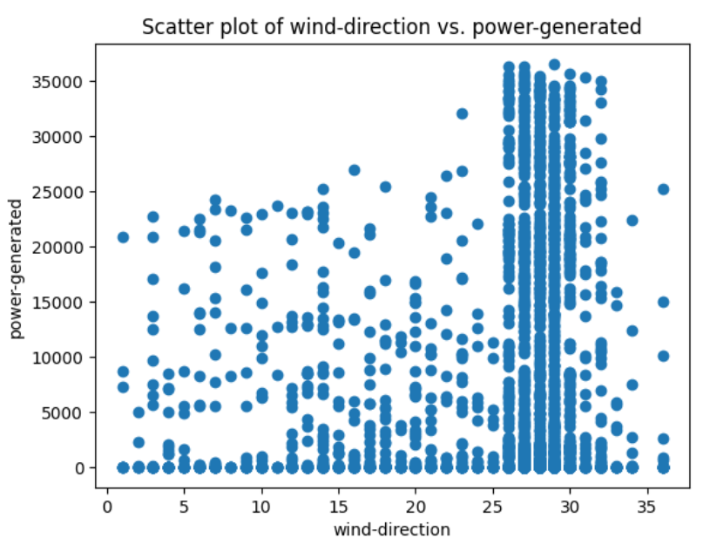
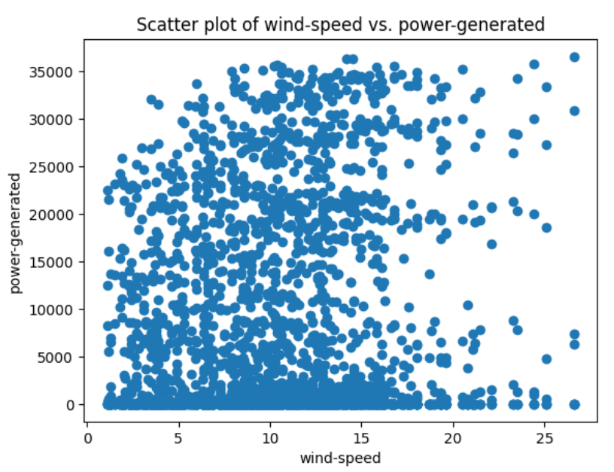
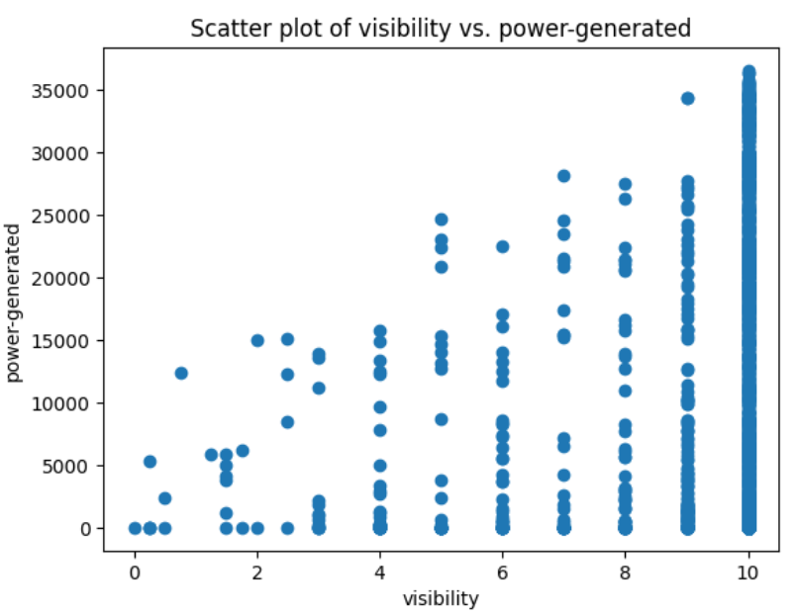
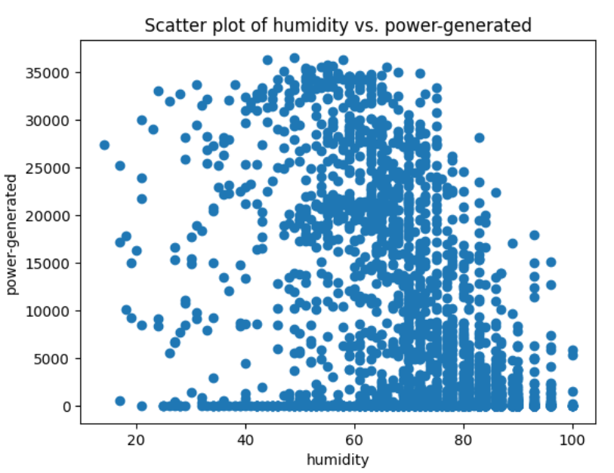
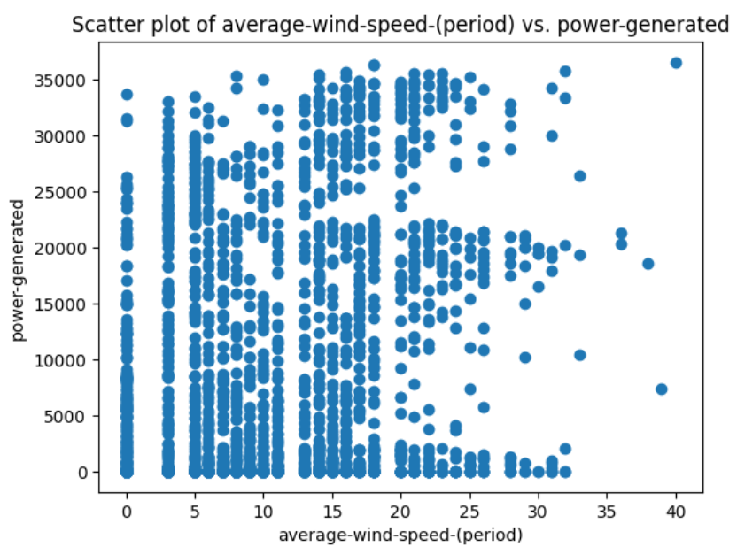
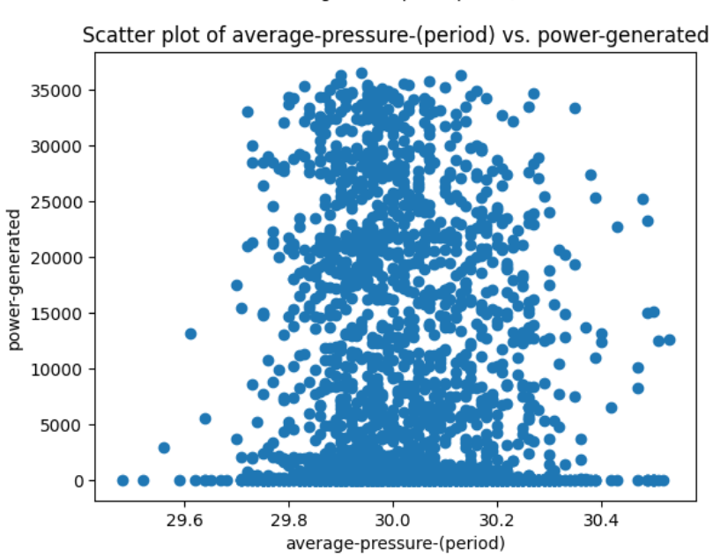
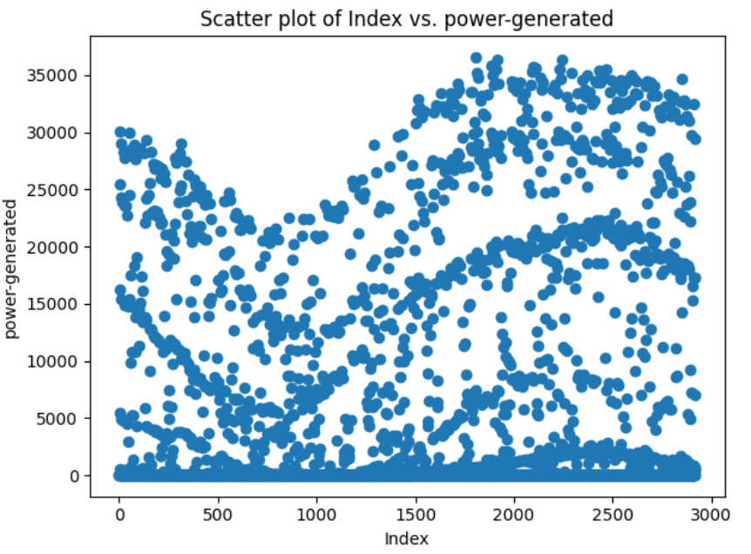
scatter PLOTS

Slide 15
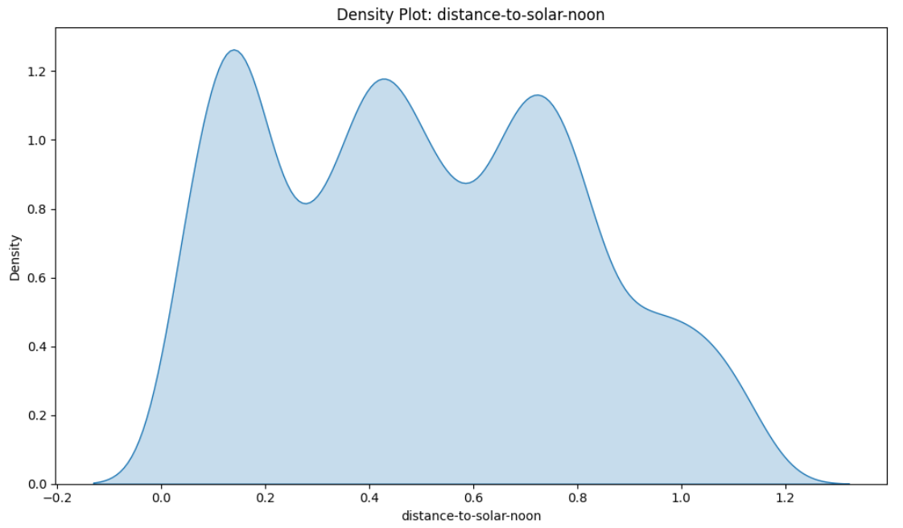
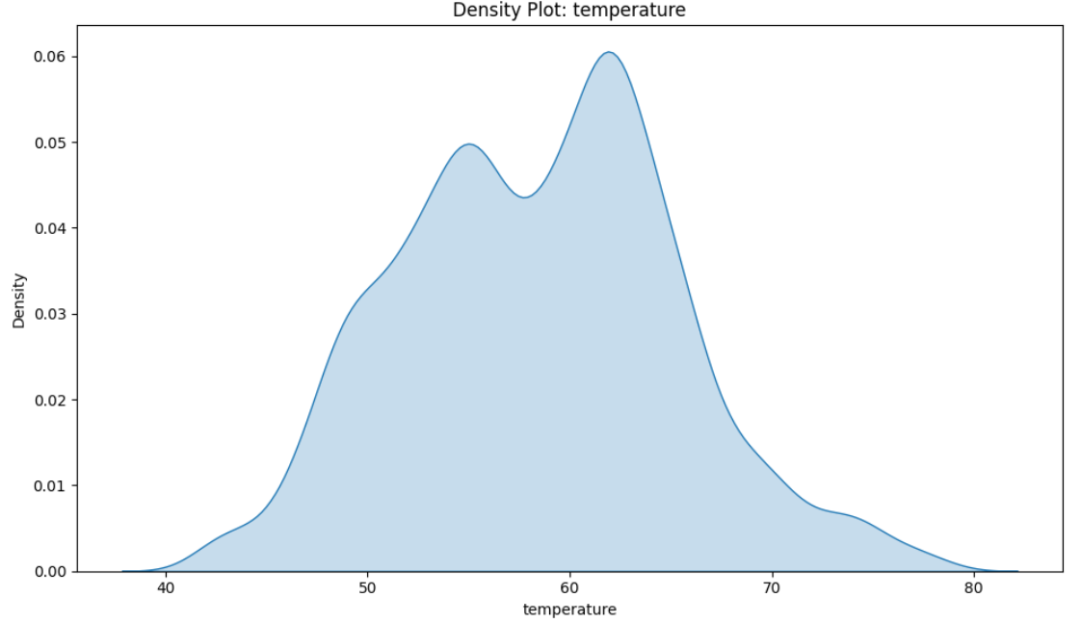
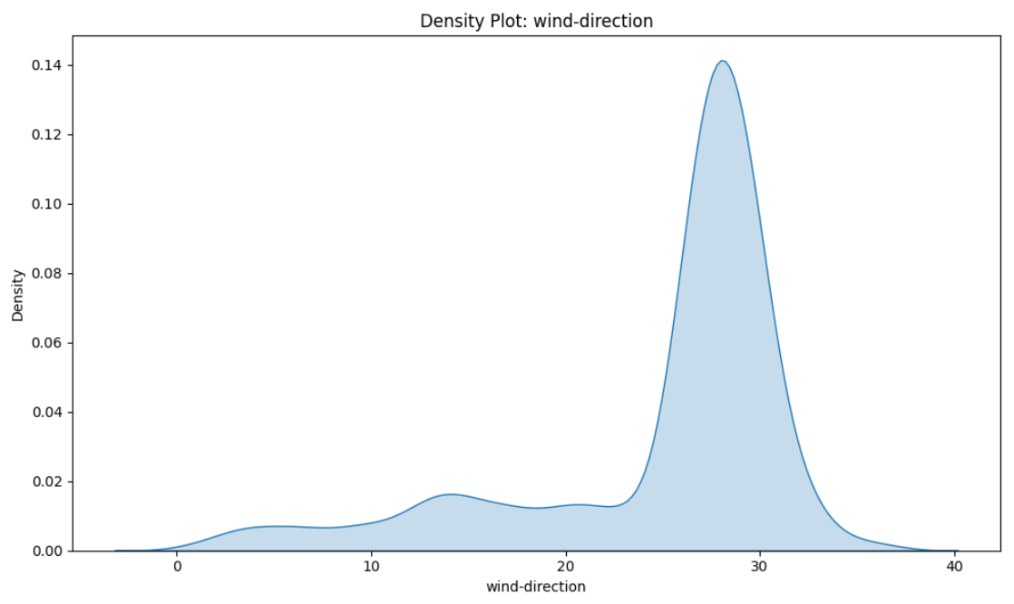
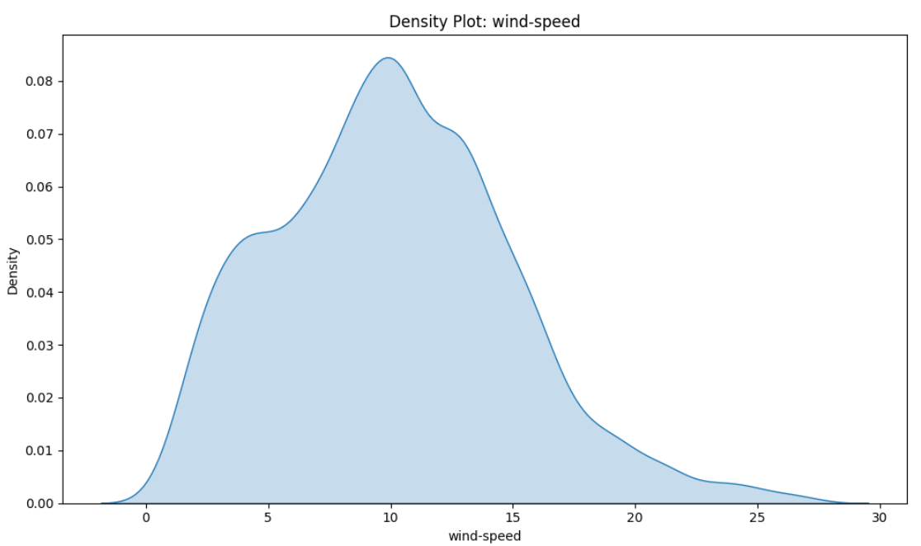
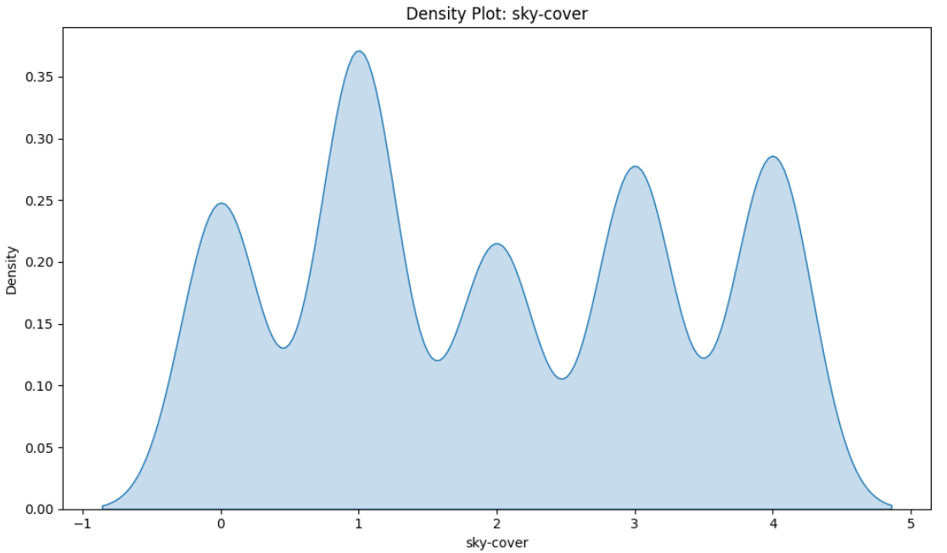
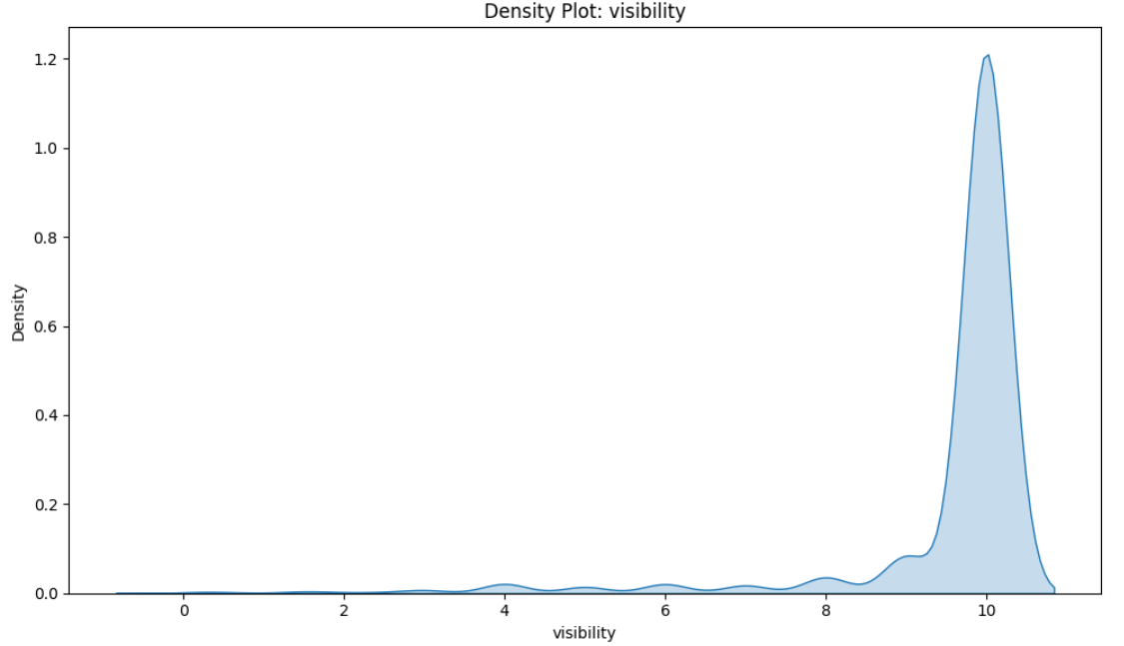
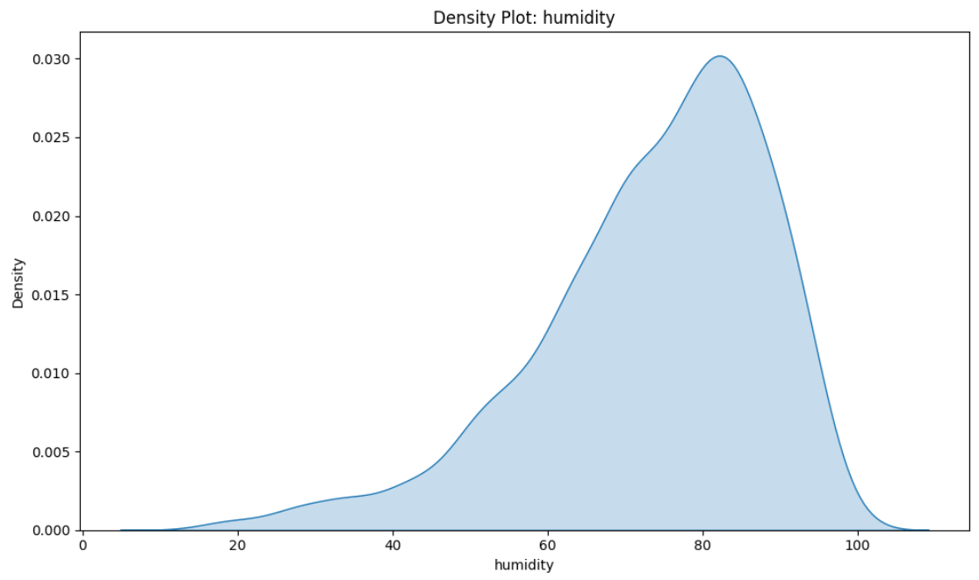
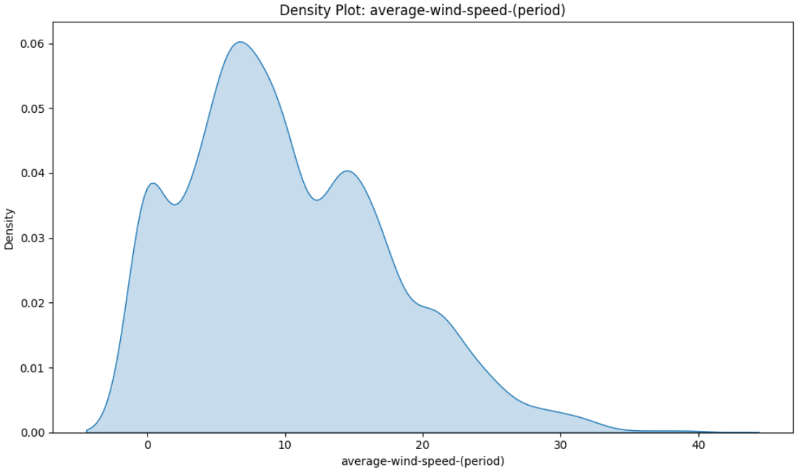
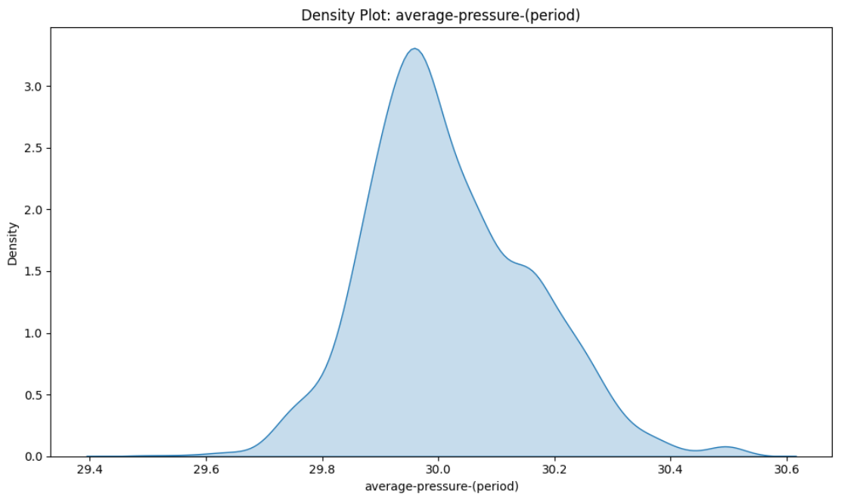
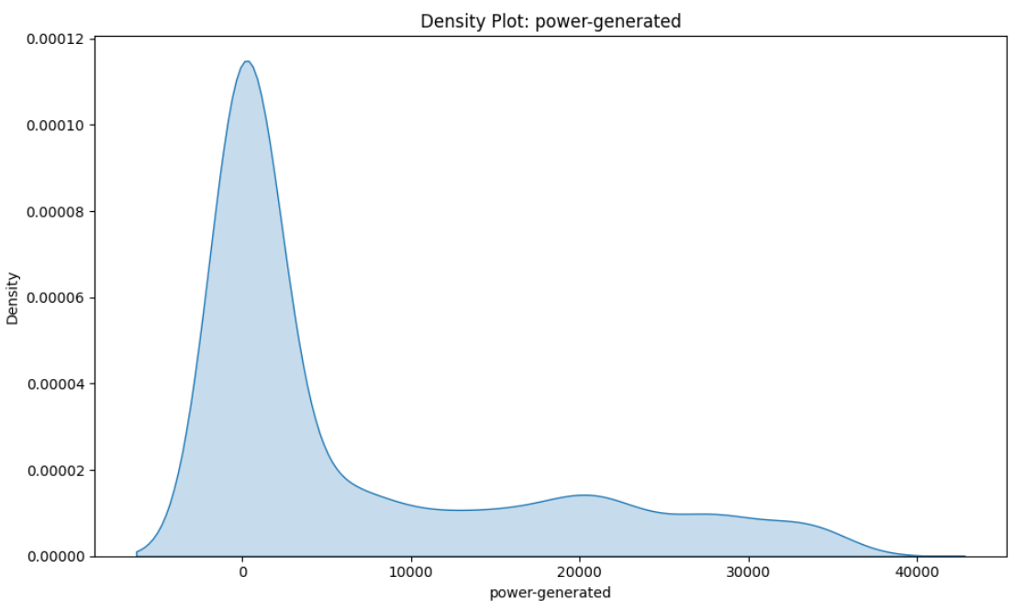
Density plots

Slide 16
Density plots insights
Distance-to–solar-noon, temperature, sky-cover and average pressure period have a normal distribution of data.
Wind-direction, visibility and humidity are left-skewed.
Wind-speed period and power generated are right-skewed.
Wind-speed is having a kind of normal distribution but slightly right-skewed.

Slide 17
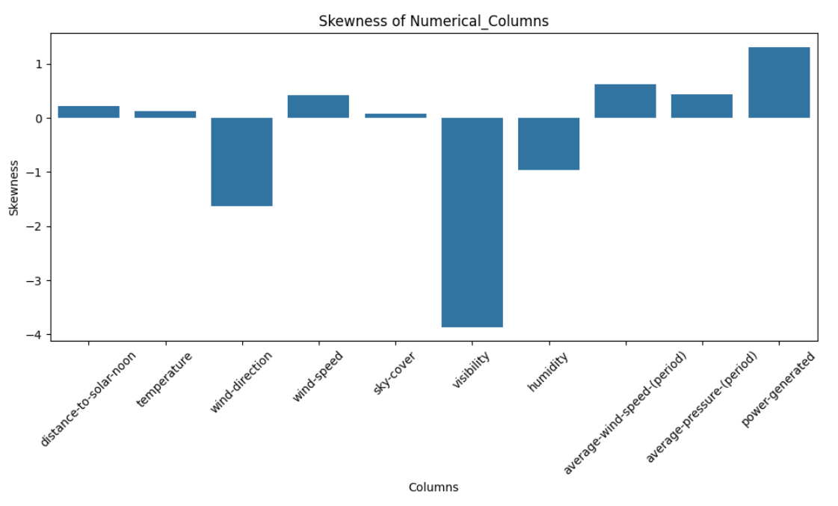
skewness

Slide 18
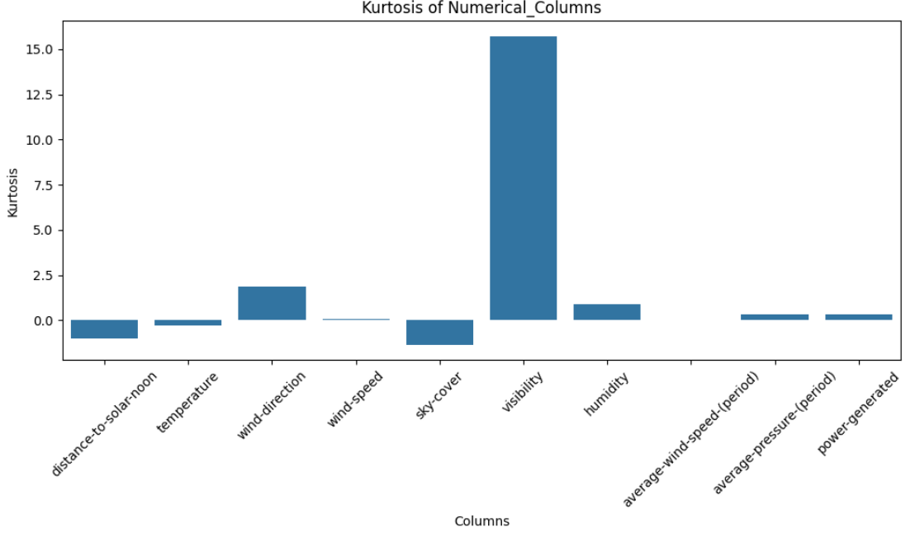
kurtosis

Slide 19
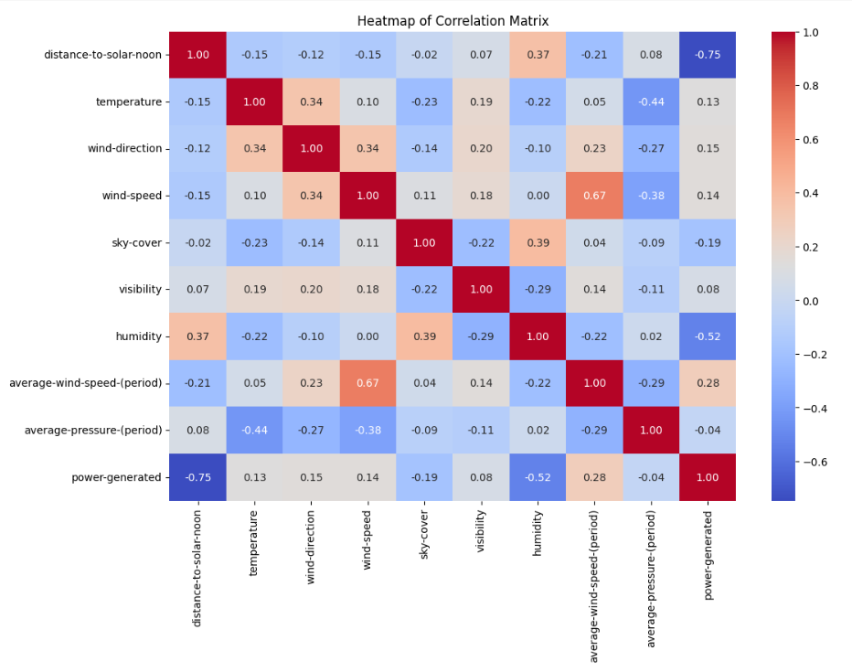
heatmap

Slide 20
Heatmap insights
Average-wind-speed-period has a high co-relation with the power generated.
Distance-to-solar-noon and humidity have a negative co-relation with the power generated.
Temperature, wind-direction and wind-speed have a positive co-relation with power generated but with a low value.

Slide 21
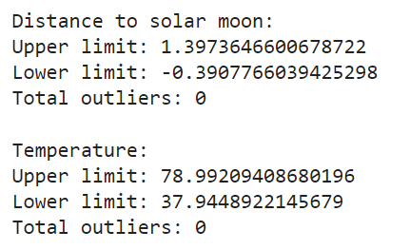
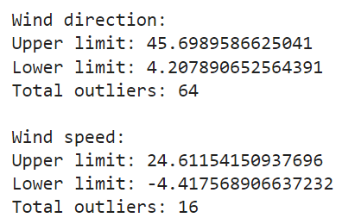



Outlier detection

Slide 22

scaling

Slide 23

Linear regression

Slide 24

lasso regression

Slide 25

ridge regression

Slide 26

Decision tree

Slide 27

Decision tree feature importance

Slide 28

Random forest

Slide 29

Random forest feature importance

Slide 30

ada boosting

Slide 31

ada boosting feature importance

Slide 32

xga boosting

Slide 33

xga boosting feature importance

Slide 34

svr

